Slide 1
CPSC 335
Smart Campus Navigation System
By: The Syntax Sages
Lark Inostroza, Nezar Humoud, Kevin Ramirez, and Ahmed Elali

Slide 2
Objectives and Roles
Team Roles
Lark Inostroza (Graph Construction and Data Integration)
Kevin Ramirez Algorithm Implementation (BFS and DFS)
Nezar Humoud Algorithm Implementation (Dijkstra’s Algorithm)
Nezar Humoud User Interface and Accessibility Features
Objectives
Develop a smart navigation system for the university campus.
Assist users in finding optimal paths to various locations on campus.
Find Routes based on distance, accessibility.

Slide 3
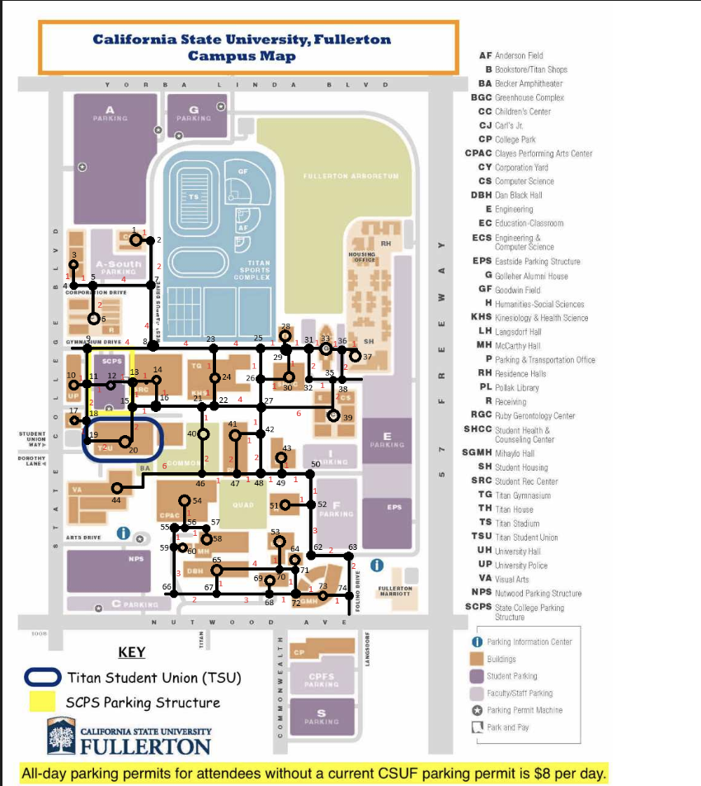
Graph Construction
Model the campus as a graph with locations as nodes and paths as edges.
Gather data on distances between locations, estimated travel times, and accessibility features.
Organize data into a format suitable for algorithm usage, such as an adjacency list or matrix.

Slide 4
Closer Look of Campus
The graph variable is defined as a dictionary where each key represents a node/location on the campus and the corresponding value is another dictionary representing the connected nodes and the weight of the edges.
For example, node '1' is connected to node '2' with an edge weight of 1. Node '2' is connected back to node '1' with an edge weight of 1 and also to node '7' with an edge weight of 2.
The graph continues to define the connections for various nodes with their respective edge weights, creating a network representing the layout of the campus.
This graph data structure will be used in pathfinding algorithms like BFS, DFS, and Dijkstra's Algorithm to find routes between different locations on the campus based on the specified criteria such as shortest path, all possible paths, or shortest weighted path.
The graph data structure is then used to create an instance of the CampusNavigator class, passing the graph as a parameter, and initializing the GUI for the campus navigation system.

Slide 5
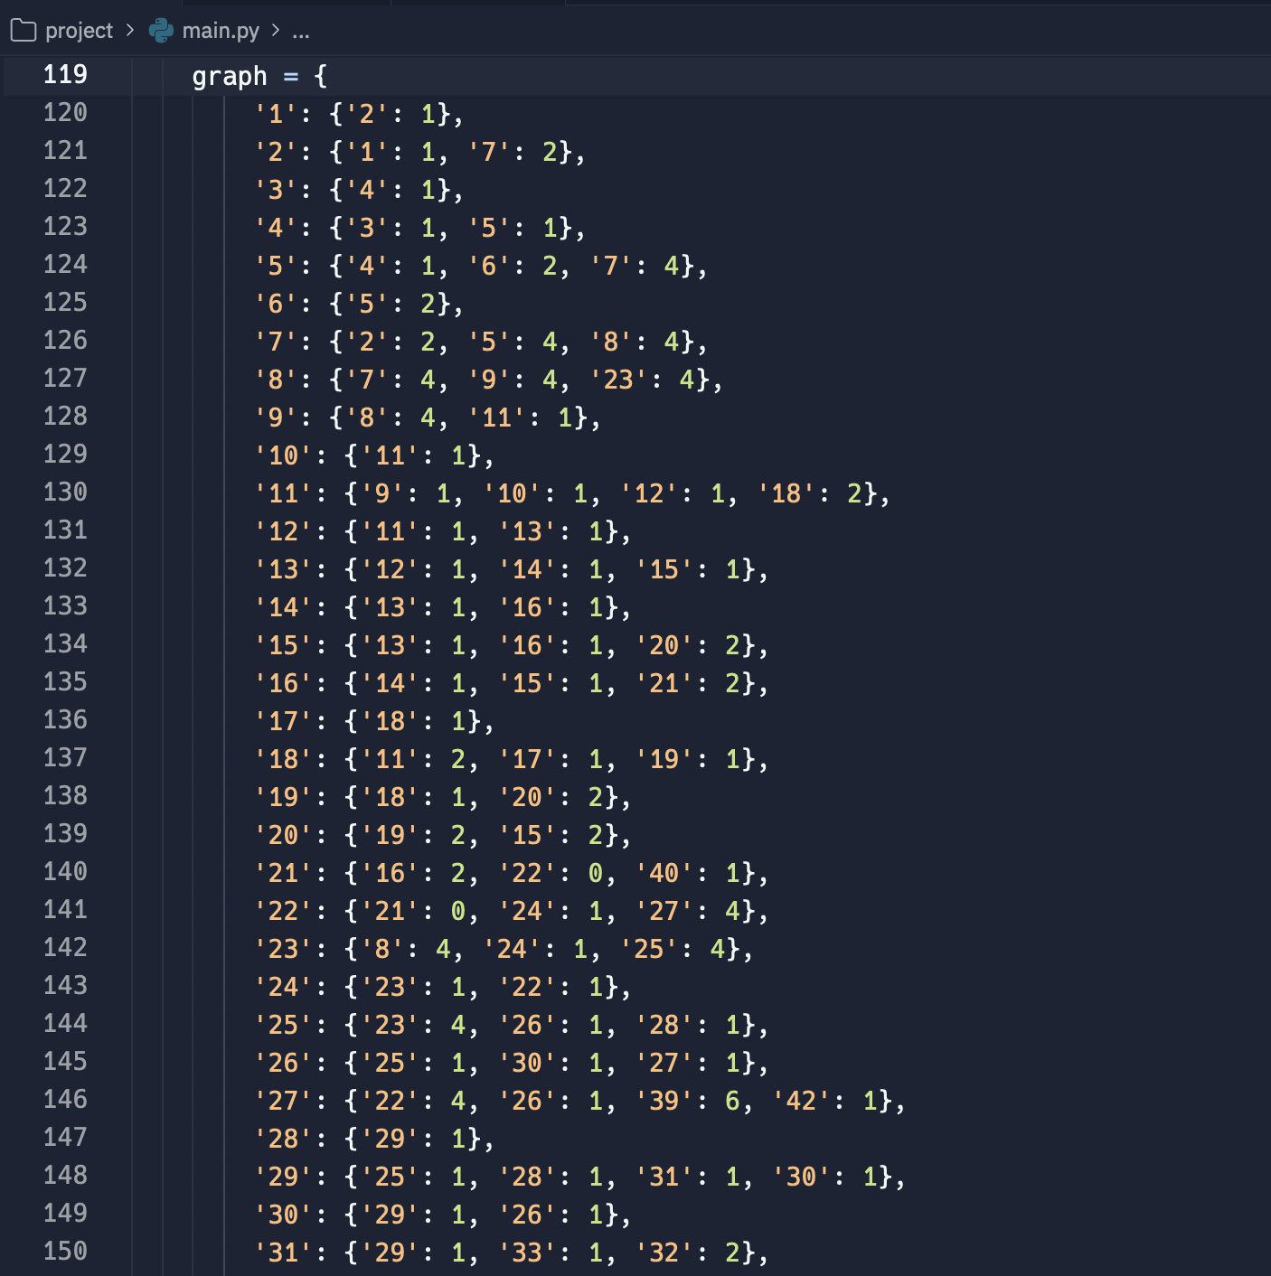
Nodes and Edges for Location/Path
This code defines a graph representing a campus map, where nodes denote locations and edges represent paths between locations. Each node is a dictionary with keys representing connected nodes and values representing edge weights. The graph structure serves as a basis for pathfinding algorithms like BFS, DFS, and Dijkstra's Algorithm to find routes between locations based on criteria such as shortest path or shortest weighted path. Finally, an instance of the CampusNavigator class is created using this graph, initializing a GUI for the campus navigation system.

Slide 6
Algorithm Implementation (BFS & DFS)
BFS:
BFS is used to find the shortest path by the number of edges (stops).
Explores nodes in layers, starting from the initial node.
Guarantees the shortest path in terms of edges for unweighted graphs.
DFS:
DFS explores all possible paths and may discover routes with specific characteristics, such as scenic routes passing by landmarks.
Traverses as far as possible along each branch before backtracking.
Can be useful for exploring diverse routing options beyond shortest paths.

Slide 7
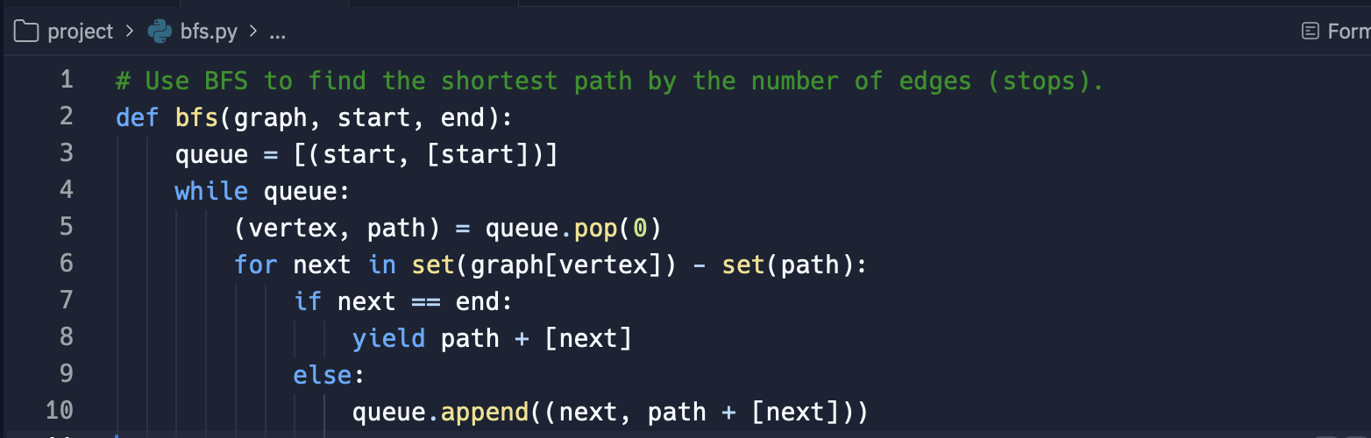
Breadth First Search (BFS) Algorithm
This code defines a function named bfs which implements the Breadth First Search (BFS) algorithm to find the shortest path between a starting node and an ending node in a graph by the number of edges (stops). It takes three parameters: the graph structure, the starting node, and the ending node. The function uses a queue to explore nodes level by level until it finds the shortest path. When the ending node is reached, it yields the shortest path found.

Slide 8
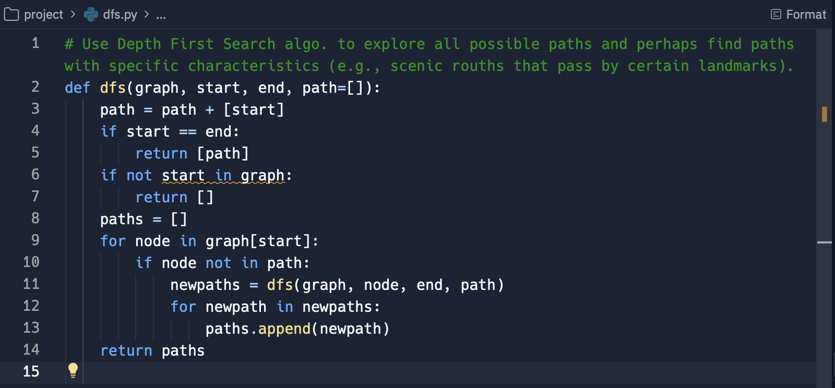
Depth First Search (DFS) Algorithm
This code defines a function named dfs which implements the Depth First Search algorithm to explore all possible paths in a graph from a starting node to an ending node.
It takes four parameters: the graph structure, the starting node, the ending node, and optionally a path parameter which is a list containing the nodes visited so far.
The function returns a list of all paths found from the starting node to the ending node.

Slide 9
Algorithm Implementation (Dijkstra’s Algorithm)
Dijkstra's Algorithm is a single-source shortest path algorithm that works on graphs with non-negative edge weights.
It finds the shortest path from a source node to all other nodes in the graph.
Uses a priority queue to greedily select the node with the smallest distance from the source and relax its neighboring nodes.

Slide 10
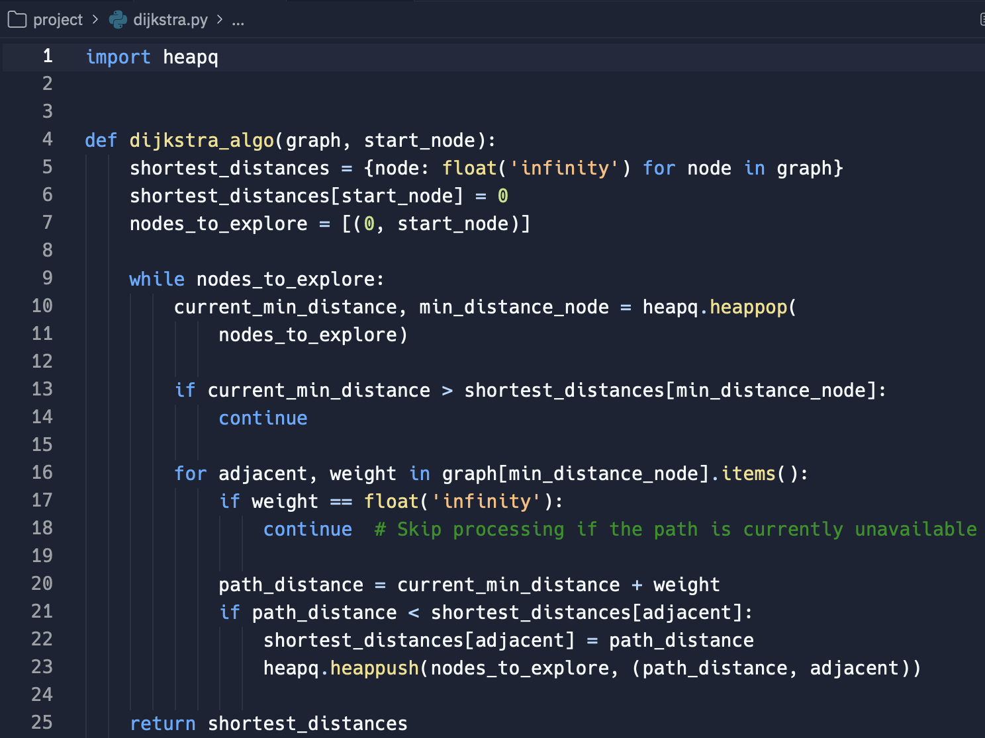
Dijkstra’s Algorithm
This code implements Dijkstra's algorithm for finding the shortest paths from a single source node to all other nodes in a graph. It imports the heapq module for efficient priority queue implementation.
The dijkstra_algo function takes two parameters: the graph structure and the starting node. It initializes a dictionary to store the shortest distances from the starting node to each node in the graph. Then it uses a priority queue to explore nodes based on their current minimum distance from the start node.
The algorithm continues until all nodes have been explored, updating the shortest distances as it progresses. Finally, it returns the dictionary containing the shortest distances to all nodes from the starting node.

Slide 11
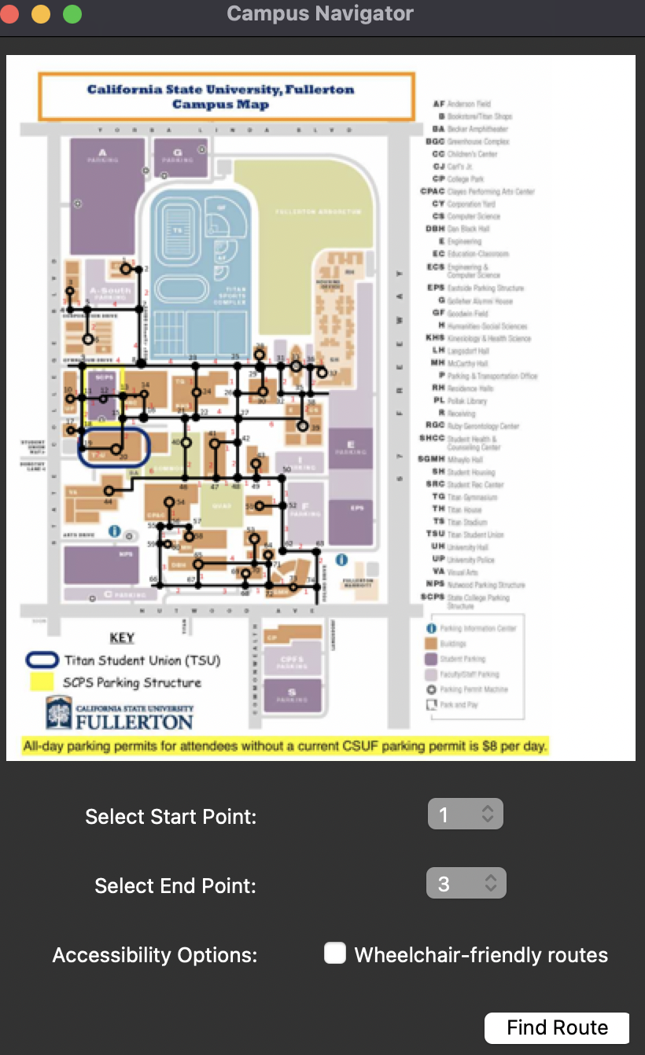
User Interface & Accessibility
Developed a simple and intuitive UI for users to input their start and end points on the campus map.
Integrated a feature catering to users with diverse needs, such as wheelchair accessibility or avoidance of steep inclines.

